Slide 1
Nuclear Chemistry

Slide 2

Nuclear Chemistry

Slide 3
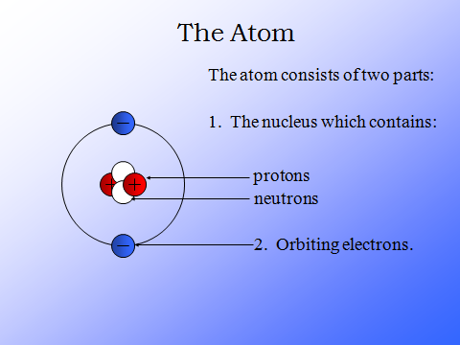
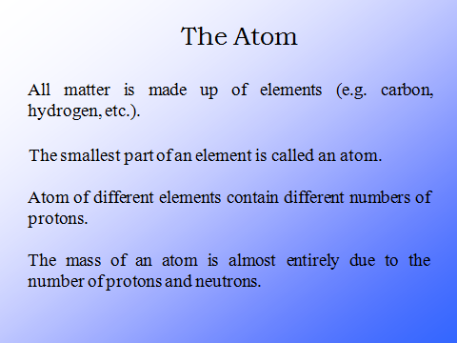

Slide 4
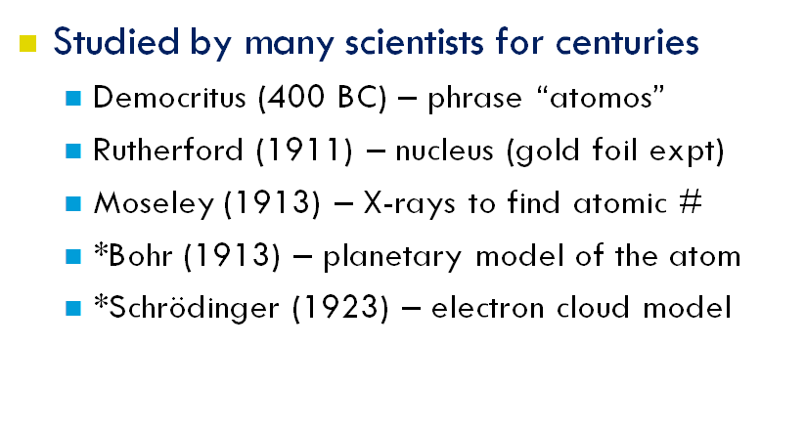
Who studied the atom?

Slide 5

Development of Atomic Models
One of concept of atom was proposed by the ancient Greek philosopher, Democritus. Democritus and his followers believed that every object or matter found in this world is composed by the minute, invisible, indivisible particles called atom. Atom is the simplest and smallest division of an object or matter. The word atom is derived from Greek atomos meaning “unable to be cut”
According to Democritos, atoms are made up of precisely the same matter, but atoms of different elements differ in shape, size, weight, arrangement, and position. The size, shape, and arrangement of atoms of a substance determinethe substance properties.
The followings are descriptions of atomic models development by scientists after Democritus and the modern atomic model believed at the present day.

Slide 6

Dalton’s Atomic Model
In the early 19-th century (1808), a British chemist and physicist “John Dalton” (1766-1844) studied thoroughly how different elements, such as hydrogen and oxygen, could combine to form another substance ex. water. Dalton made two assertions about atoms, which is :
Atoms of each element are all identical to one another, but different from the atoms of all other elements
Atom of different elements can combine to form more complex substances

Slide 7
Dalton’s Atomic Theory (experiment based)
All elements are composed of tiny indivisible particles called atoms
Atoms of the same element are identical. Atoms of any one element are different from those of any other element.
Atoms of different elements combine in simple whole-number ratios to form chemical compounds
In chemical reactions, atoms are combined, separated, or rearranged – but never changed into atoms of another element.

Slide 8
Limitations of Dalton’s atomic theory
According to Dalton’s atomic theory atoms combine in the ratio of small whole numbers to form compounds. This is not seen in complex organic compounds like sugar C12H22O11. Ratio of C, H and O is 12:22:11 which is not simple.

Slide 9

Thomson’s Atomic Model
Since the discovery of electron as an elementary particle which is negatively charged, the validity of Dalton’s atomic theory begans to be questionable. In 1899, a british physicist, Sir Joseph Thomson, proposed :
An atomic model callaed raisin plum pudding model.
Thomson described atom as a positively charged sphere containing several negatively charged particles called electrons. Electrons are scattered in the sphere like raisins in a plum pudding
-
+
+
-
-
-
+
+

Slide 10
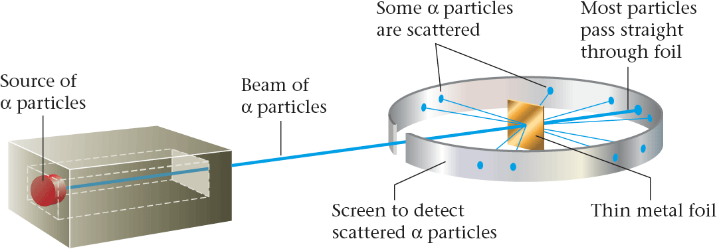
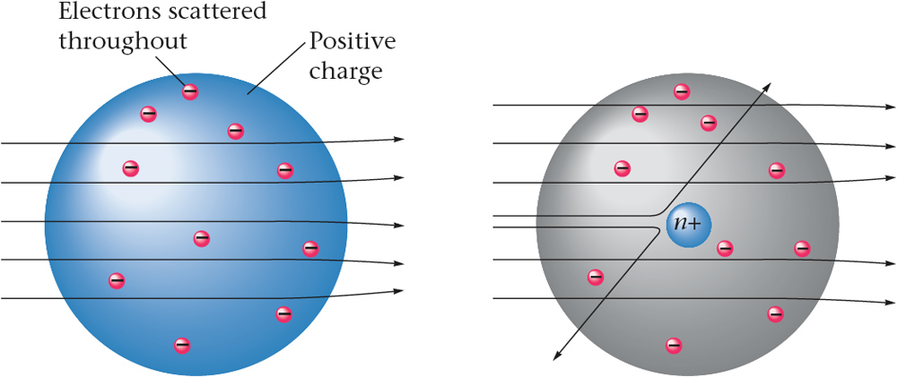
  Rutherford’s Experiment
Observations
(i) most of the α– particles passed through the gold foil undeflected.
(ii) a small fraction of the α–particles was deflected by small angles.
(iii) a very few α– particles (∼1 in 20,000) bounced back, that is, were deflected by nearly 180°.
Conclusions
1.Most of the space in the atom is empty
2. The positive charge has to be concentrated in a very small volume
that repelled and deflected the positively
charged α– particles
3.Rutherford showed that the volume occupied by the nucleus is negligibly small as compared to the total volume of the atom. The radius of the atom is about 10–10 m, while that of nucleus is 10–15 m.

Slide 11

Rutherford’s Atomic Model
In 1911, Ernest Rutherford. Geiger and Marsden carried out an experiment by shooting the particles (α) on a thin plate of gold to prove the Thomson’s atomic theory or model as follows
An atom consists of an atomic nucleus which is positively charged. The nucleus of atom contains almost entire mass of the atom and is surrounded by electrons which are negatively charged as in the solar system model
Entirely, an atom is neutral because the number of its positive charges (protons) is equal to that of its negative charges.
During revolving the nucleus, the centripetal force on electrons in an atom is produced by the forces of attraction between the electrons and nucleus ( coulomb force )

Slide 12
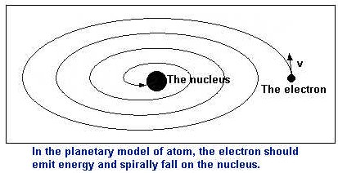
Defects in Rutherford’s model of atom
(i) When electron (Negatively charged particle) revolve continuously around the positively charged nucleus then energy would be lost and due to the attraction of nucleus electron will merge with the nucleus. Rutherford has no explanation for this problem.
(ii) If electron will continuously radiate energy then its spectra should be continuous but this is not the case. Atoms give line
spectra.
In order to overcome the defects of Rutherford Neil Bohr proposed the atomic model.

Slide 13
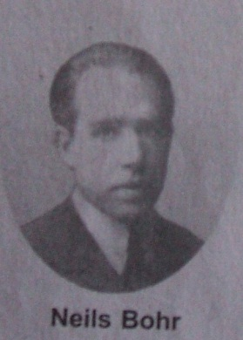
Bohr’s Atomic Model
The weaknesses of Rutherford’s atomic theory in explaining the line spectrum of hydrogen atom was succesfully corerected by a Danish physicist, Neils Bohr, in 1913. Based on the Rutherford’s atomic theory and Planck’s quantum theory, Bohr proposed postulates dealing with an atomic model as follows :
n=3
n=2
n=1
Electrons of an atom revolve around the nucleus at a certain path called stationary path. At This path, the electrons do not absorb or release energy and they have an angular momentum whose magnitude is the multiplication of
Electrons will release energy (in the form photon) if they are moving from a higher to a lower energy level (from outer to the inner path) and the electrons will absorb energy when they are moving from a lower to a higher energi level (from the inner to the outer path)

Slide 14
Bohr’s Atomic Model
Bohr’s atomic theory brings about the “Quantum number” concept. The principal quantum number in Bohr’s atomic theory represents the positive integer (n = 1, 2, 3 ….) denoting the electron’s trajectory (orbit) in the atom as well as denoting the energy level of electron.

Slide 15
Subatomic Particles
In the modern atomic theory, atom is composed by subatomic subatomic particles : electrons, protons and nuetrons. This statement has something to do with the discoveries of particles of electrons, protons and neutrons by the scientists, as we are going to study as follws.
1. The Discovery of Electron
In 1897, Thomson discovered the value of specific charge of electron (e/m), that is the ratio of charge to mass of electron. To determine the value of e/m, Thomson used the magnetic and electric fields which are set in the path of electron.
In 1906, Robert A. Millikan succeeded in determining the value of electron charge from oil drop experiment. In this case the value of e = 1,6 x 10⁻¹⁹ C is the value of an elementary particle, that is electron. Accordingly, from the value of specific change (e/m), the mass of an electron can be determined, that is 9,11 x 10⁻³¹ kg.

Slide 16
TYPES OF NUCLEIDE
Type-I Based on protons and neutrons
1. Isotope
Isotope is one of two or more species of an element atom having the same atomic number, but differ in mass number. The examples of isotopes are carbon isotopes, namely
2. Isobar
Isobar is an atom which comes from different element but has the same mass number. The examples of the isobar are
3. Isotone
Isotone is an atom which comes from different element but has same the number of neutrons. The examples of the isotone are
4.ISOMERS – two nuclei of the same species but different energy states, of which at least one is metastable

Slide 17
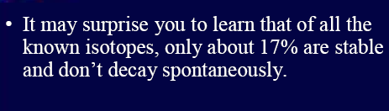
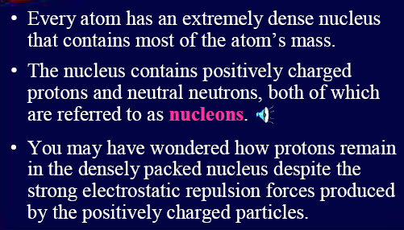
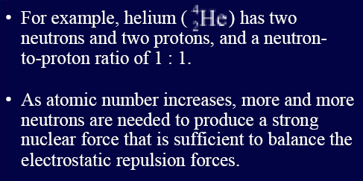
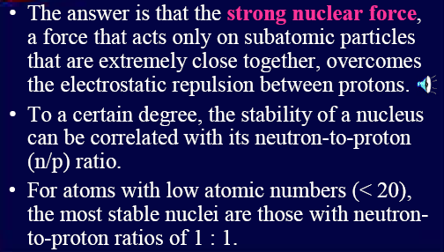
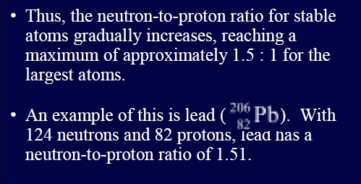
Nuclear Stability

Slide 18
Type-II Based on stability of nucleus
Mattauch’s rule (1934): Adjacent isobars cannot be stable.
2 stable isobars separated by an unstable daughter.
e.g. the isobar where A=40: ⁴⁰Ar, ⁴⁰K and ⁴⁰Ca
Even vs. odd
Magic #’s: 2, 8, 10, 20, 28, 50, 82, 126
Nuclides with either Z or N = a “magic #” are more likely to be stable

Slide 19
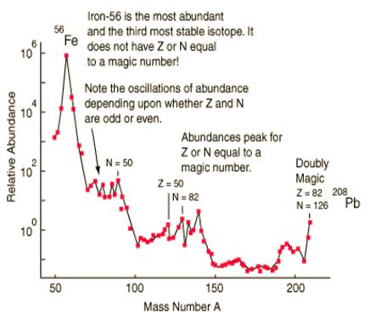
Magic numbers
Actual # of n & p affects nuclear stability
Even #’s of both n & p give stability
Similar to noble gas electron configurations: 2, 10, 18, 36, etc.
Since nucleons (= n+p) occupy energy levels within nucleus
N or Z = 2, 8, 20, 28, 50, 82, and N = 126
Magic numbers

Slide 20
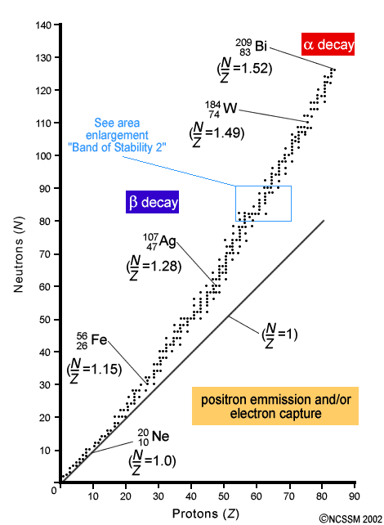
Nuclear stability.
In determining nuclear stability, ratio of neutrons to protons (N/Z) important
Notice lower part of valley (N/Z = 1)
Bi last stable (non-radioactive) isotopes
N/Z too high: above valley, too many n, convert n to p, beta-decay
N/Z too low: below valley, too many p, convert p to n

Slide 21
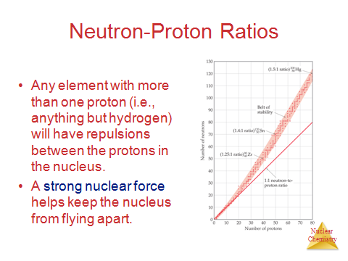
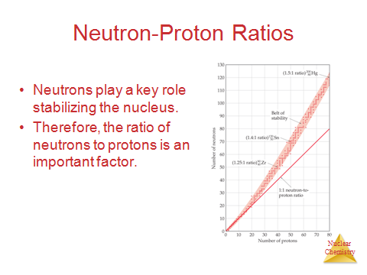
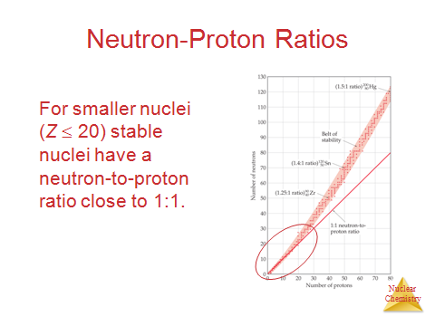
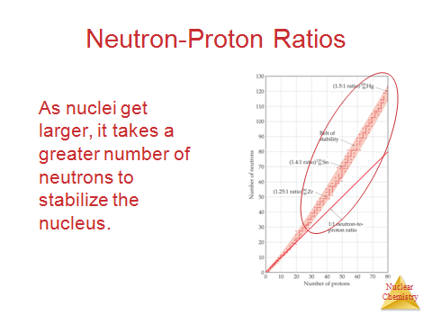

Slide 22
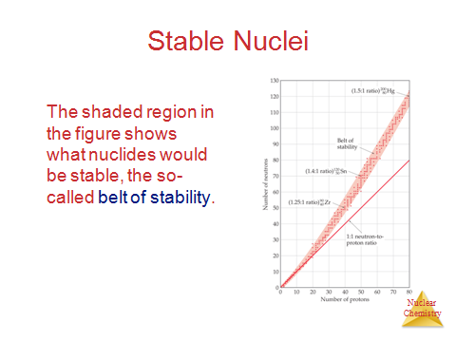
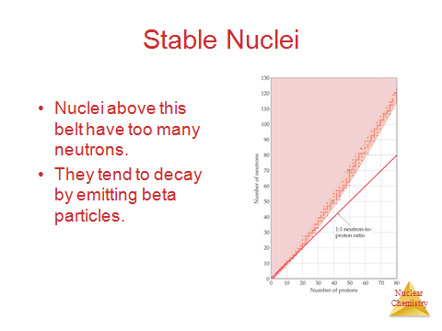
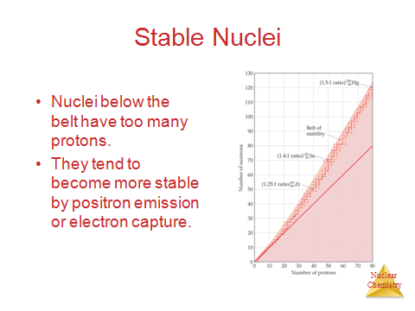
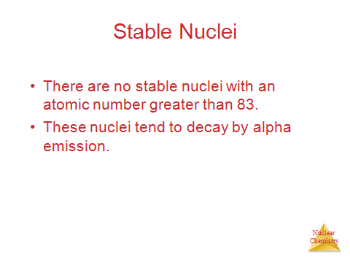

Slide 23
Subatomic Particles
In the modern atomic theory, atom is composed by subatomic particles : electrons, protons and nuetrons. This statement has something to do with the discoveries of particles of electrons, protons and neutrons by the scientists, as we are going to study as follows.
1. The Discovery of Electron
In 1897, Thomson discovered the value of specific charge of electron (e/m), that is the ratio of charge to mass of electron. To determine the value of e/m, Thomson used the magnetic and electric fields which are set in the path of electron.
In 1906, Robert A. Millikan succeeded in determining the value of electron charge from oil drop experiment. In this case the value of e = 1,6 x 10⁻¹⁹ C is the value of an elementary particle, that is electron. Accordingly, from the value of specific change (e/m), the mass of an electron can be determined, that is 9,11 x 10⁻³¹ kg.

Slide 24
The Discovery of Proton
Proton is a positively charged particle which was discovered by Eugen Goldstein through the continuation ray experiment.
According to Goldstein, when cathode rays move toward the anode in Crookes tube, their particles will collide with the hydrogen gas in the tube. The collision will cause electrons of hydrogen atom to be released, making it hydrogen atom be positively charged in the form of hydrogen ion (H⁺). This ion moves toward the chatode through the hole and collidies at the glass wall behind the cathode. The hydrogen ion is then called proton and it has mass of 1,67 x 10⁻²⁷ kg and charge of +1,6 x 10⁻¹⁹ C.

Slide 25

The Discovery of Neutron
Ruhtherford was succesful in measuring (calculating) the mass of atomic nucleus which is approximately twice as much as mass of proton in the nucleus. Therefore, according to Rutherfor, there must be another particle in the nucleus and that particle is uncharged. It was not until 1932 that J. Chadwick discovered neutron from the shooting of beryllium using alpha particles and this neutron is, then, known as the paricle which has mass of approximately 1,6 x 10⁻²⁷ kg
PROTON
NEUTRON
ELECTRON

Slide 26
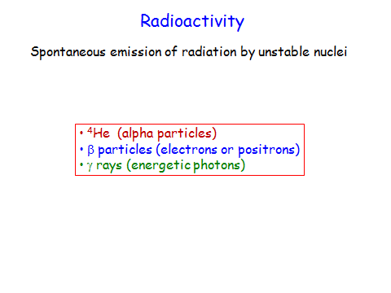

Slide 27
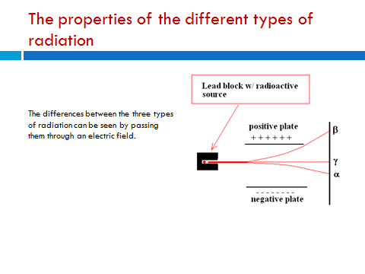
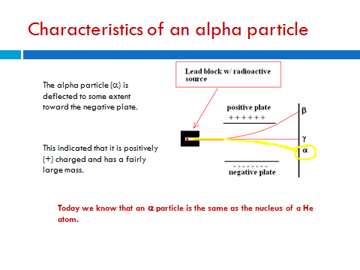
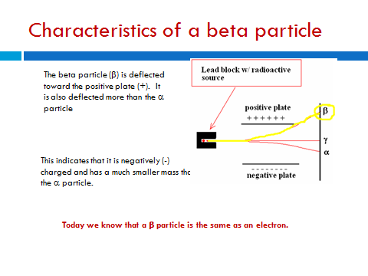
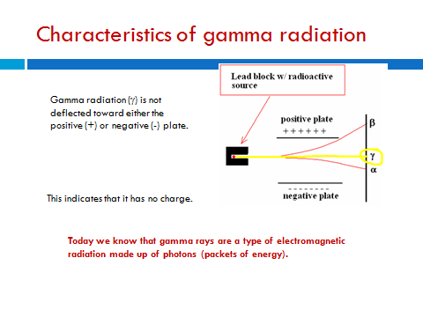

Slide 28
Penetrating power of radiation
The ability of radioactive particles to pass through air and other materials is inversely related to their mass.
Alpha particles – the least penetrating, they travel only a few centimeters through air. They can be stopped by a single sheet of paper.
Beta particles – more penetrating, they travel several meters through air. They can be stopped by a sheet of Al or plastic.
Gamma Rays – most penetrating, thick sheets of lead or concrete are required to stop gamma rays.

Slide 29
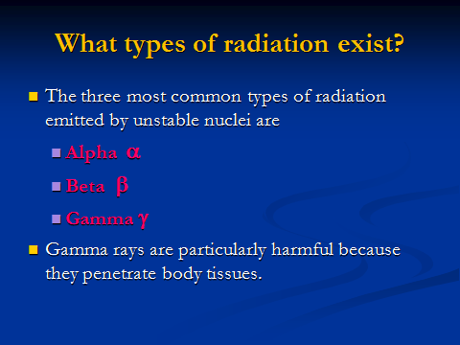
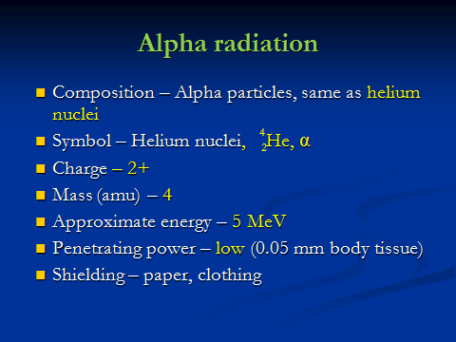
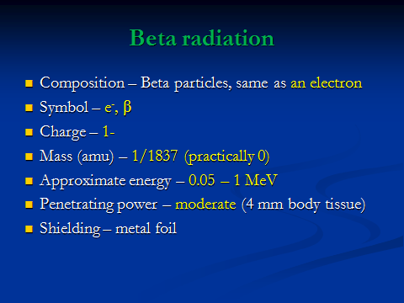
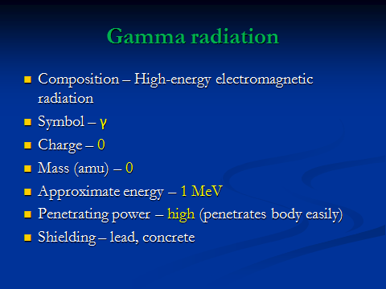

Slide 30
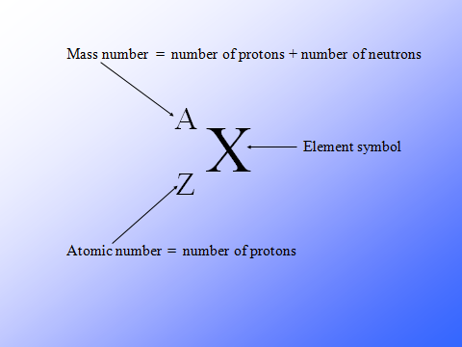
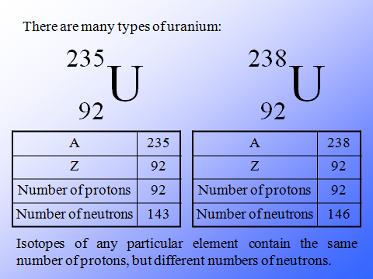
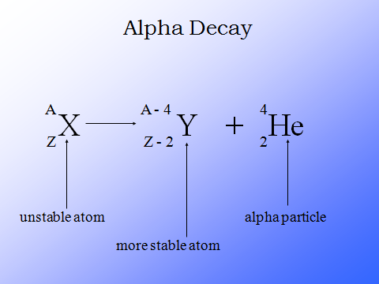
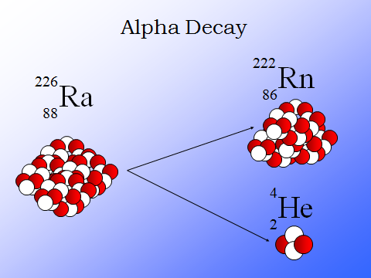

Slide 31
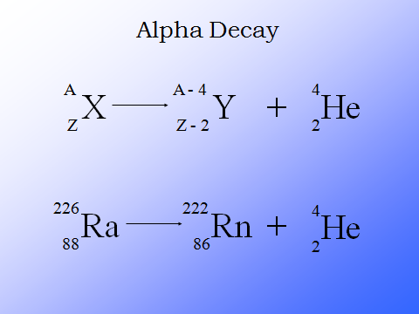
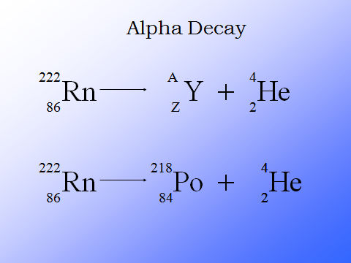
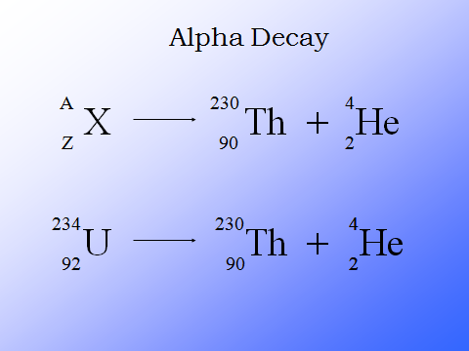
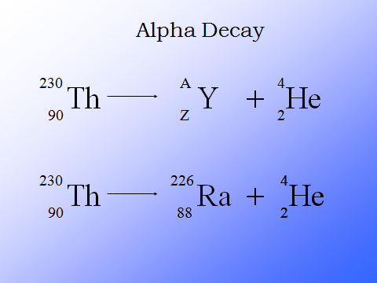
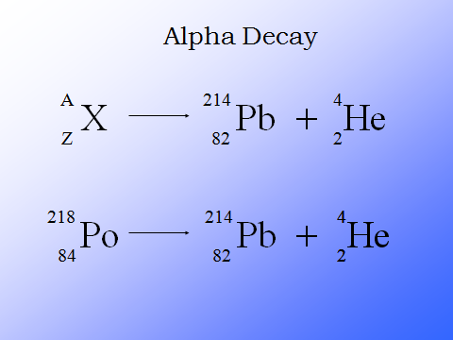

Slide 32
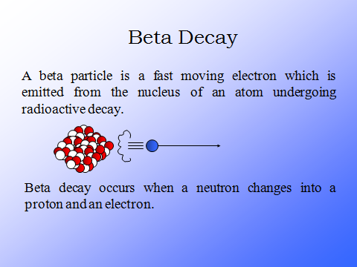
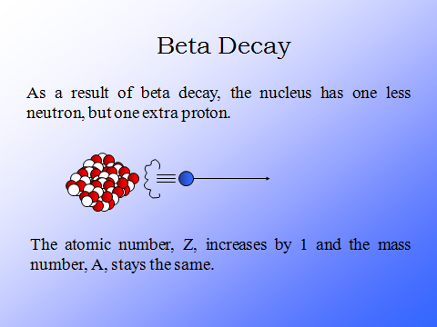
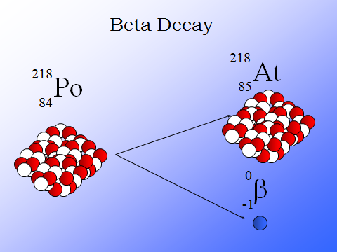
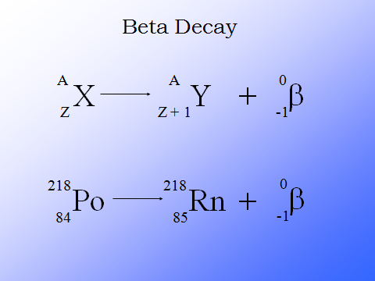

Slide 33
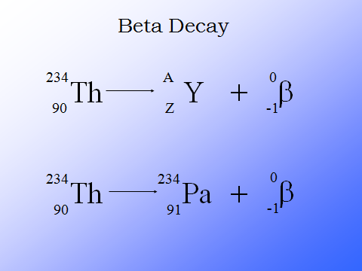
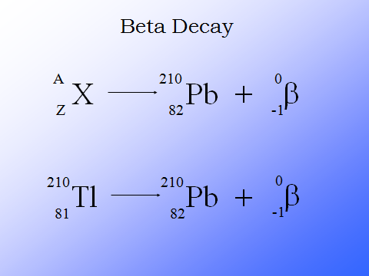

Slide 34
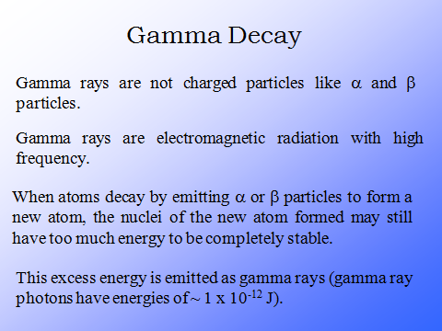
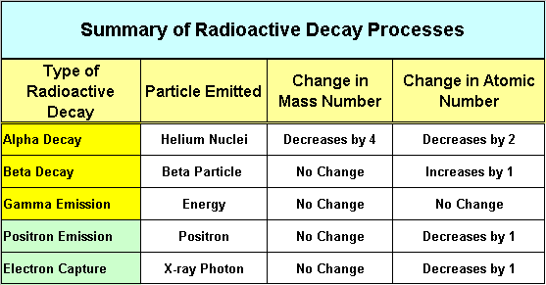

Slide 35
Nuclear Chemistry
Nuclear (NOT Nucular) chemistry involves changes in the nuclear composition (protons and neutrons) of atoms that are radioactive.
Nuclear reactions can be used as energy sources, for medical diagnosis, and for medical treatment.

Slide 36
Chemical Reactions
Breaking/forming bonds via electrons
Start and end with same number and type of atoms (conservation of mass)
ΔH ≈ -1 - 1000 kJ
Rates affected by temperature, pressure, concentration, catalyst

Slide 37
Nuclear Reactions
Change one element into another via changes in nucleus (protons, neutrons)
Change elements (lead CAN be turned into gold)
ΔH can be -10¹⁰ kJ
Rates can only be affected by changing concentrations

Slide 38
Chemical vs. Nuclear Reactions
Chemical Reactions | Nuclear Reactions
Occur when bonds are broken | Occur when nuclei emit particles and/or rays
Atoms remain unchanged, although they may be rearranged | Atoms often converted into atoms of another element
Involve only valence electrons | May involve protons, neutrons, and electrons
Associated with small energy changes | Associated with large energy changes
Reaction rate influenced by temperature, particle size, concentration, etc. | Reaction rate is not influenced by temperature, particle size, concentration, etc.

Slide 39
Two types of Nuclear Reactions
Radioactive decay/emission: an unstable atom emits a particle or energy. This is a naturally occurring process and we can’t stop or change it.
Example:
Transmutation: when atoms are bombarded by particles, a reaction might occur
Example:

Slide 40
Nuclear Reactions - Types
When the target nuclei are bombarded by particles, there are some general types of interactions
Elastic Scattering
When no energy is transferred between the target nucleus and the incident particle, the process is known as ²⁰⁸Pb elastic scattering
²⁰⁸Pb (n, n) ²⁰⁸Pb, Q = 0.
Inelastic Scattering
When energy is transferred, the process is called inelastic scattering
⁴⁰Ca (a, a') ^{40m}Ca, Q =\= 0.
where a and a' have different kinetic energies.
In cases when the incident particle is a complicated nuclide, it may also be left in excited state,
²⁰⁸Pb (¹²C, ^{12m}C) ^{208m}Pb
This process is called mutual excitation

Slide 41
Nuclear Reactions - Types
Capture Reactions
Both charged and neutral particles can be captured by nuclei. For example,
¹⁹⁷Au (p, g) ¹⁹⁸Hg
²³⁸U (n, g) ²³⁹U
Neutron capture reactions are used to produce many radioactive nuclides.
Rearrangement Reactions
The absorption of a particle accompanied by the emission of one or more particles is called a rearrangement reaction.
¹⁹⁷Au (p, d) ^{196m}Au
⁴He (a, p) ⁷Li
²⁷Al (a, n) ³⁰P
⁵⁴Fe (a, d) ⁵⁸Co
⁵⁴Fe (a, 2 n) ⁵⁶Ni
⁵⁴Fe (³²S, ²⁸Si) ⁵⁸Ni
Various rearrangement reactions change the number of neutrons and the number of protons of the target nuclide.

Slide 42
Nuclear Reactions - Types
Fission Reactions
Typical and well-known neutron-induced fission reactions are:
²³⁵U (n, 3 n) fission products
²³⁹Pu (n, 3 n) fission products
These reactions release energy. The released neutrons induce further reactions, causing contineous chain reactions.
Fusion Reactions
The fusion reaction of deuterium and tritium is particularly interesting because of its potential of providing energy for the future.
T (d, n) He

